Slide 1
STRATEGIC PROBLEM
MGTA 452
FINAL PROJECT
Job seekers often look for resources such as Glassdoor for jobs in the analytics industry but find it difficult as the platform is not analytics centric.
JOB RECOMMENDER TOOL
ASK
Create a recommender tool which takes various input from the job seeker such as industry, company, location and recommend the best job available for the person.
APPROACH
Scraped data from Glassdoor and performed data cleaning and EDA. Finally, we used statistics and RShiny to build a recommender tool.
GROUP 16
Arnav Agarwal | Lauren Hu | Mrinal Agarwal | Wen-Hsuan Hung

Slide 2
AGENDA
INTRODUCTION
WEB SCRAPING
DATA CLEANING
Exploratory Data Analysis
RECOMMENDER SYSTEM
TOOL DEMONSTRATION

Slide 3
INTRODUCTION
MSBA students have been busy with Academic work, its really hard to look for jobs/ internships amongst all this.
Build a recommender tool using jaccard principle and RShiny.

Slide 4



WEB SCRAPING
Glassdoor Website
Web Scraping
Data

Slide 5
WEB SCRAPING
About the data:
Initially created by picklesueat.
Contains more than 2000 job listings for analyst positions.
Features:
Job Roles:
Data
Salary Estimate
Business Analyst
Location
Data Engineer
Company Rating
Data Analyst
Job Description
Data Scientist

Slide 6
Data Cleaning
Multiple strings in one cell
Misplaced values
Split strings to single values (eg. calculate average salary from salary interval)
Take out unwanted strings (eg. Removing numbers attached to company name.)
Empty cells
Mixed data type
Cleaned Data
Take out/fill in with zeros (eg. remove cells that contains “-1” as empty responses)
Convert data to the same type (eg. turn “False” to zero)
Database is organized and clean for analysis!
Notes:
Raw data is not always clean, we need to process our data so it can be ready to use for analysis.

Slide 7
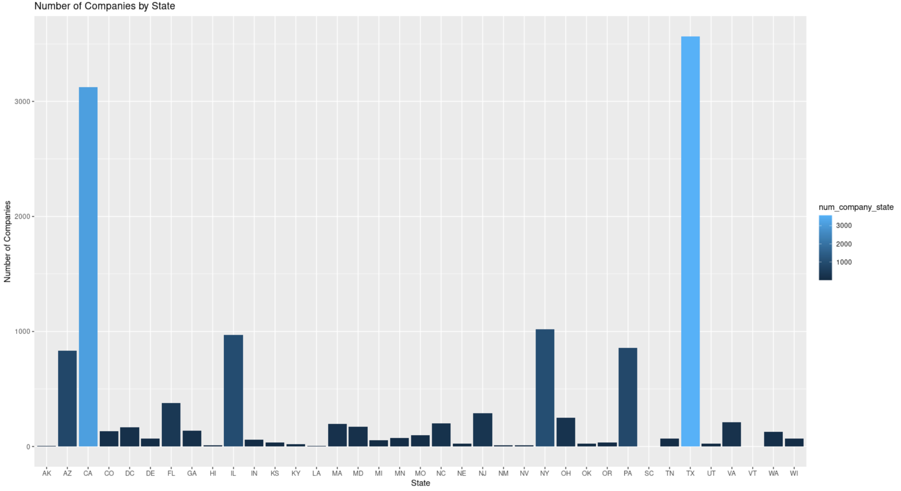
Dat
Data Visualization
TX
Number of Companies by State
CA
Top 5 Number of Job Offerings by States
Texas – 3,565
California – 3,122
New York – 1,020
Illinois - 968
Pennsylvania - 859
IL
NY
PA

Slide 8
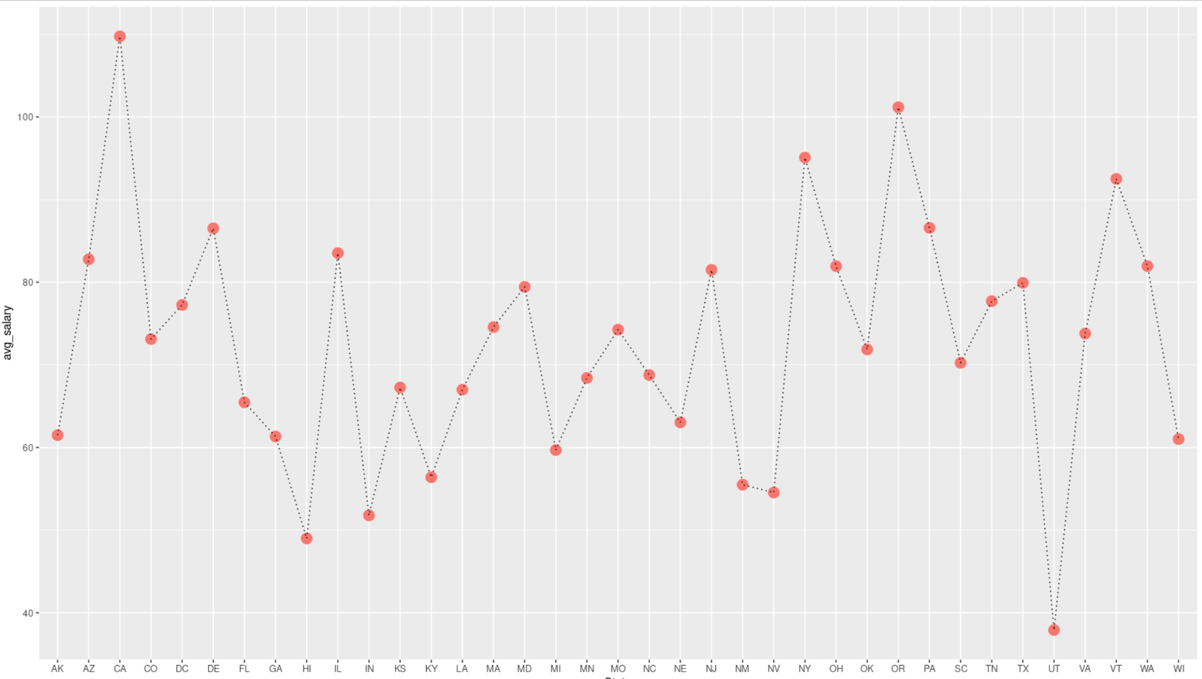
Data Visualization
Top 3 Average Salary by State
CA
OG
NY
Top 3 average salary by states
CA - 110k
OG - 101k
NY - 95.1k

Slide 9
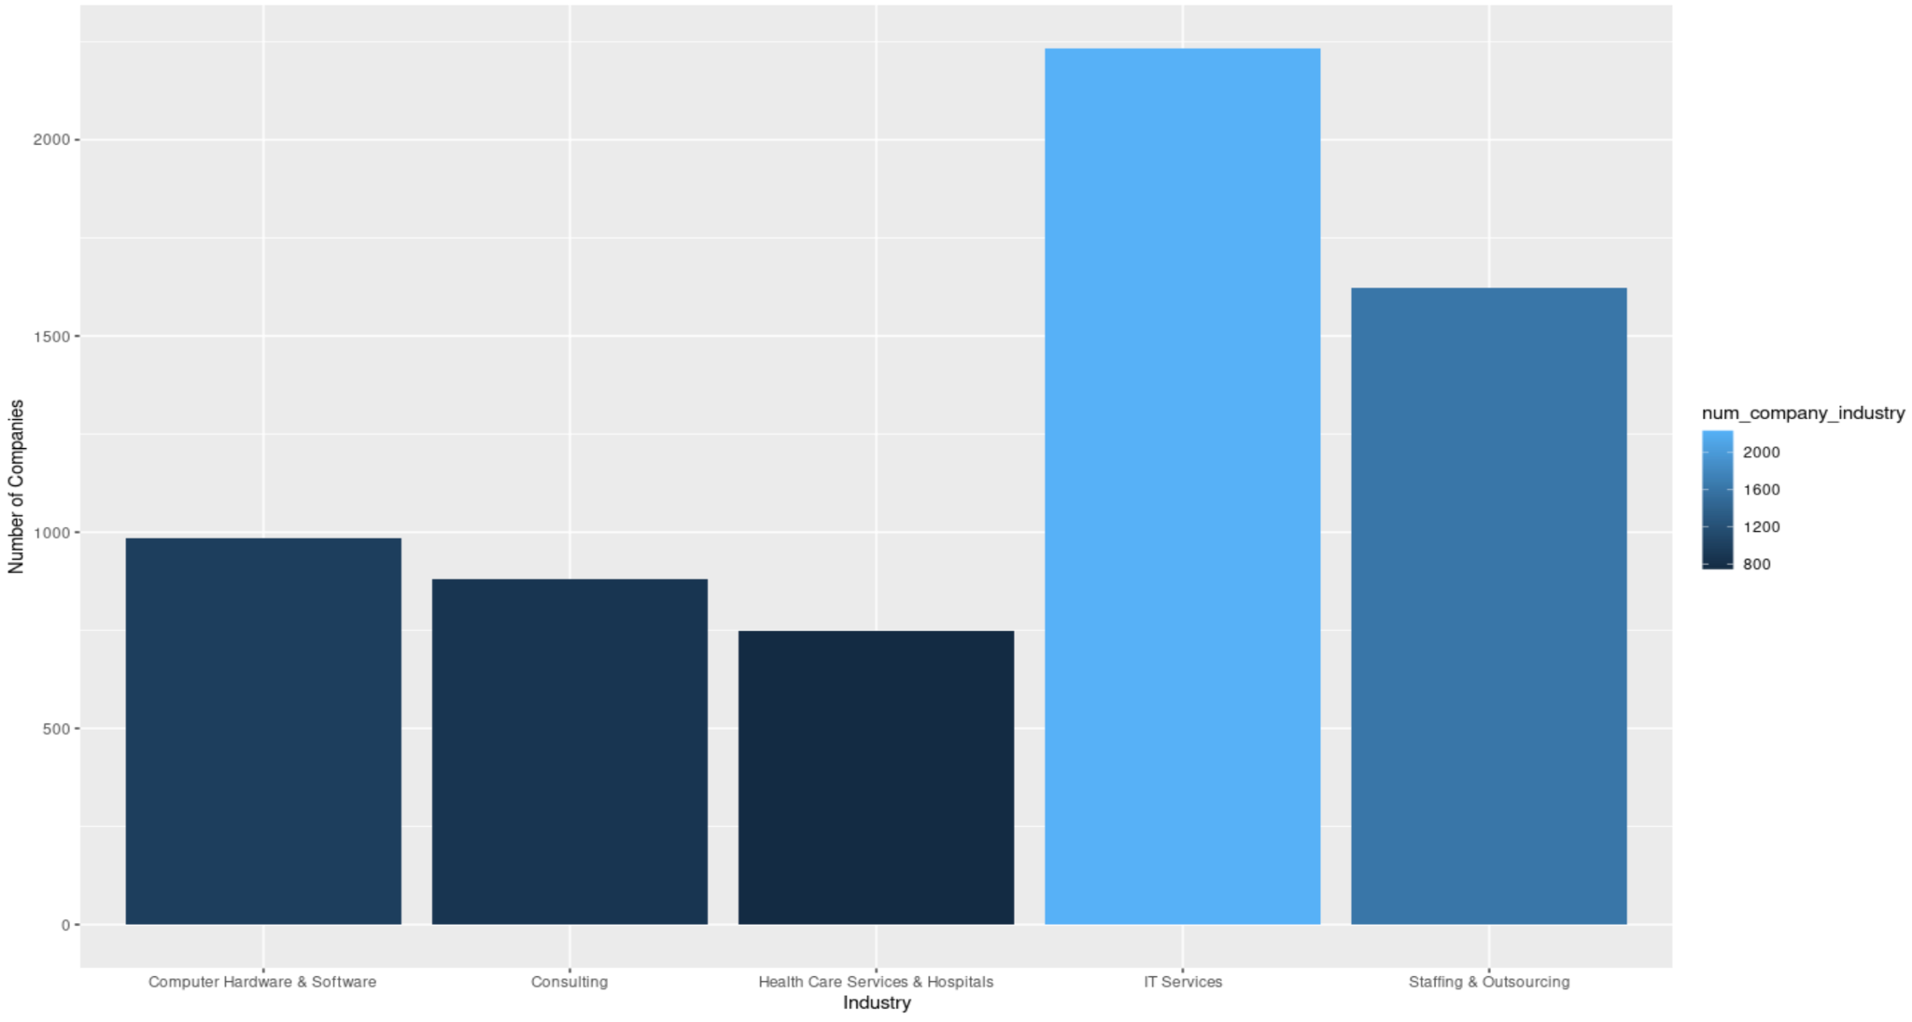
Dat
Data Visualization
Top 5 Number of Companies by Industry
IT Services
Staffing & Consulting
Top 5 Number of Job Offerings by Industry
IT Services – 2,233
Staffing & Consulting – 1,624
Computer Hardware & Software-985
Consulting - 881
Health Care Service & Hospital - 750
Computer Hardware
& Software
Health Care Service & Hospital
Consulting

Slide 10
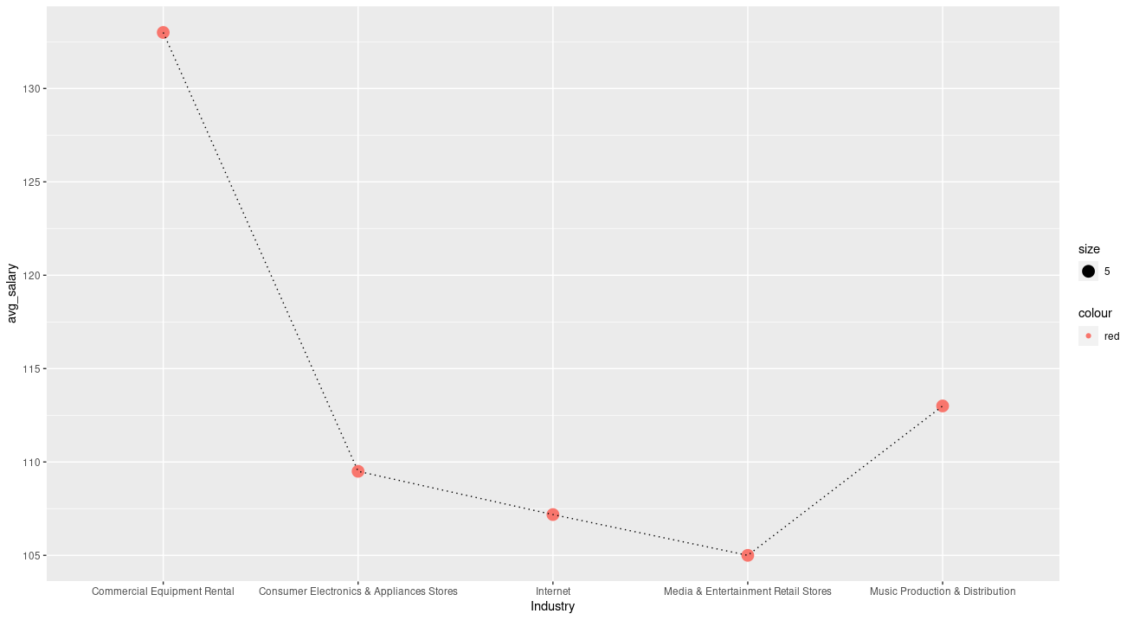
Dat
Data Visualization
Top 3 Average Salary by Industry
Commercial Equipment Rental
Top 3 Average Salary by Industry
Commercial Equipment Rental - 133k
Music Production & Distribution - 110k
Consumer Electronics & Appliances Store - 107k
Music Production & Distribution
Consumer Electronics & Appliances Store

Slide 11
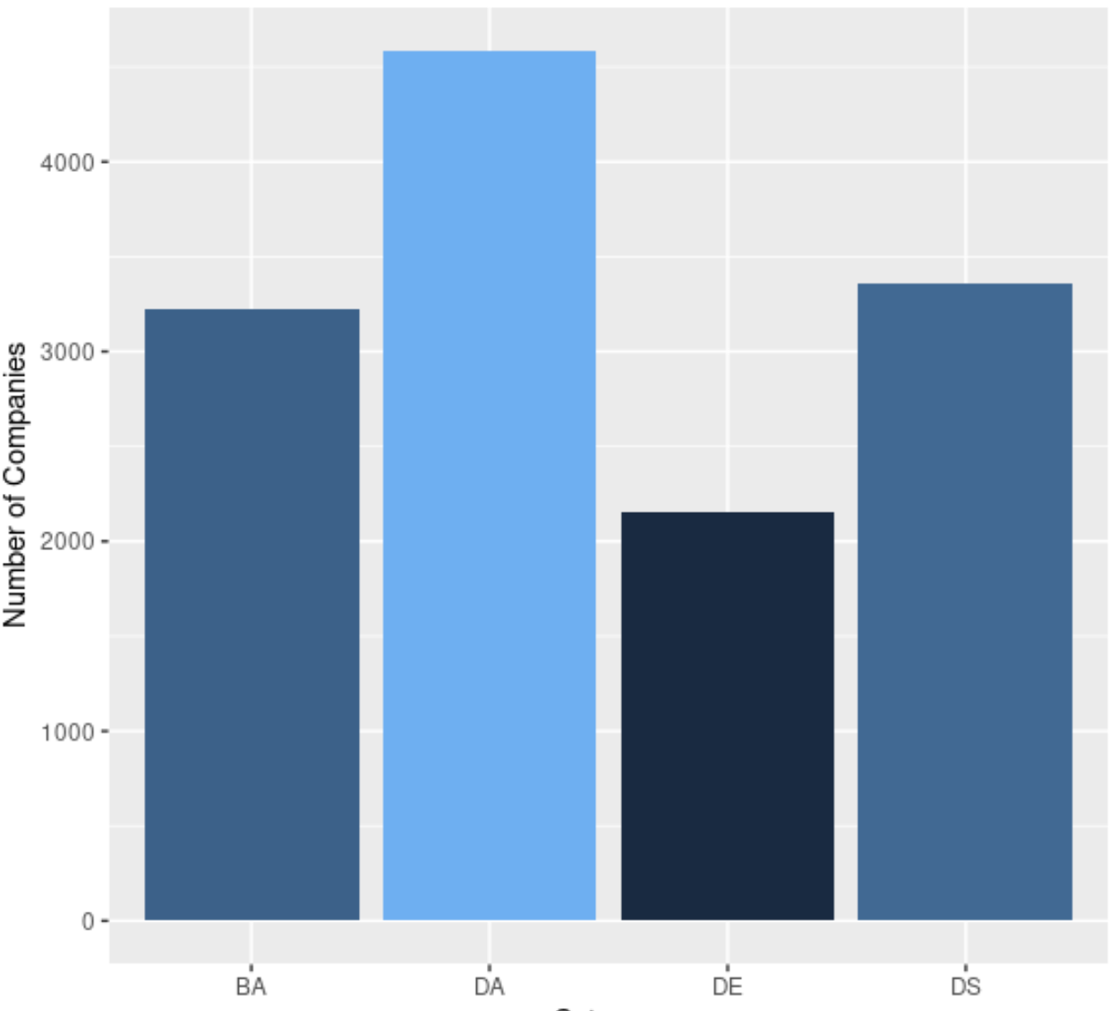
Dat
Data Visualization
Number of Companies by Category
Number of Job Offerings by Category
Data Analyst – 4,587
Data Scientist – 3,359
Business Analyst – 3,226
Data Engineering – 2,150

Slide 12
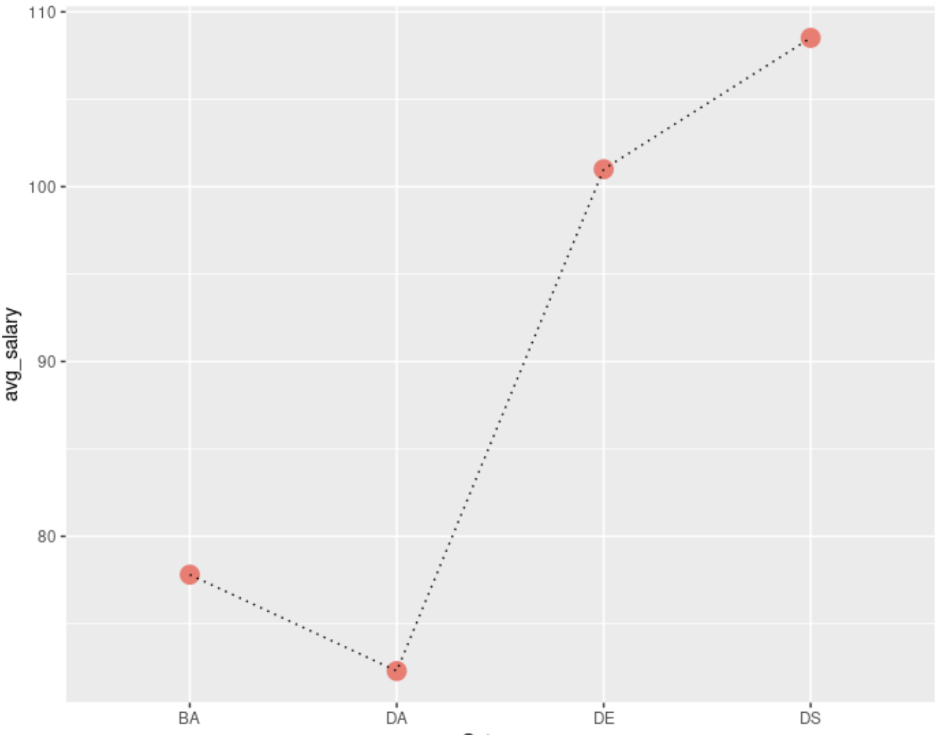
Dat
Data Visualization
Average Salary by Category
Average Salary by Category
Data Scientist - 109k
Data Engineering – 101k
Data Analyst - 72k
Business Analyst - 78k

Slide 13
Dat
RECOMMENDER SYSTEM
The process that the recommender system work
Step 1
Filter data based on User Input
Step 2
Recommend companies with
Top 5 similarity
Filter out Job position, Skills, Industry based on user input
To find out what are the skill requirements of a company, we tokenize job description, and compare the similarity between the keywords from job description and user skills
Calculate Jaccard Similarity between user’s skills and job requirement.
Notes:
Our recommender system contains two steps , the first step is filtering the job position, skills, and industry based on user input.For example, if the user choose business analyst, data analyst as desired position, R, Python, SQL as skillset he/she has, and tech as the industry that user wants to work in, the recommender system will filter data from glassdoor information.
The next step is recommend companies which has top 5 similarity with user's skill.
We calculate jaccard similarity between user's skill and job requiremen

Slide 14
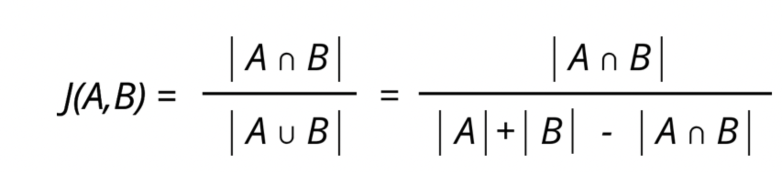
Dat
RECOMMENDER SYSTEM
Calculate the skill similarity between user and company based on Jaccard Similarity.
Company A
Python, R, SQL, Tableau, PowerBI, Excel
Jaccard Similarity for Company A and User A = { Python, R, SQL} / { Python, R, SQL, Tableau, PowerBI, Excel, Java}
= 3 / 7 = 0.4286
User A
Python, R, SQL, Java
Jaccard Similarity for Company B and User A = { Python, R} / { Python, R, SQL, Tableau, PowerBI, Excel, Java}
= 2 / 7 = 0.2857
Company B
Python, R, Tableau, PowerBI, Excel
Company A has higher recommendation ranking than company B for user A
Calculated the Jaccard Similarity for the user and each company, and recommend Top 5 companies which companies’ requirements most match user’s skill.
Notes:
What is jaccard similarity and how will it related with our recommender system
The formula of jaccard similarity is the intersection of element A and B divided by the union of A and B
For example, if company A requires applicants to require Python, R, SQL, Tableau, PowerBI, Excel, and user A has python, R, SQL, Java skill. the Numerator will be the amount of the skills that both company A and user A have, and the denominator will be the amount that all the skills that company A and user A have. So we get 3 /7 =
if there's another company B that requires applicants to have Python, R, Tableau, PowerBI, Excel. the Numerator this time will be 2, and the denominator will be 7, thus we get0.28
For user A, Company A has higher recommendation ranking than company B for user A
What the recommender system do is that:
Next, Mirnal will talk more about the app we built

Slide 15


TOOL
Accumulated the work done so far and…
Created a
R Shiny based
recommendation tool

Slide 16
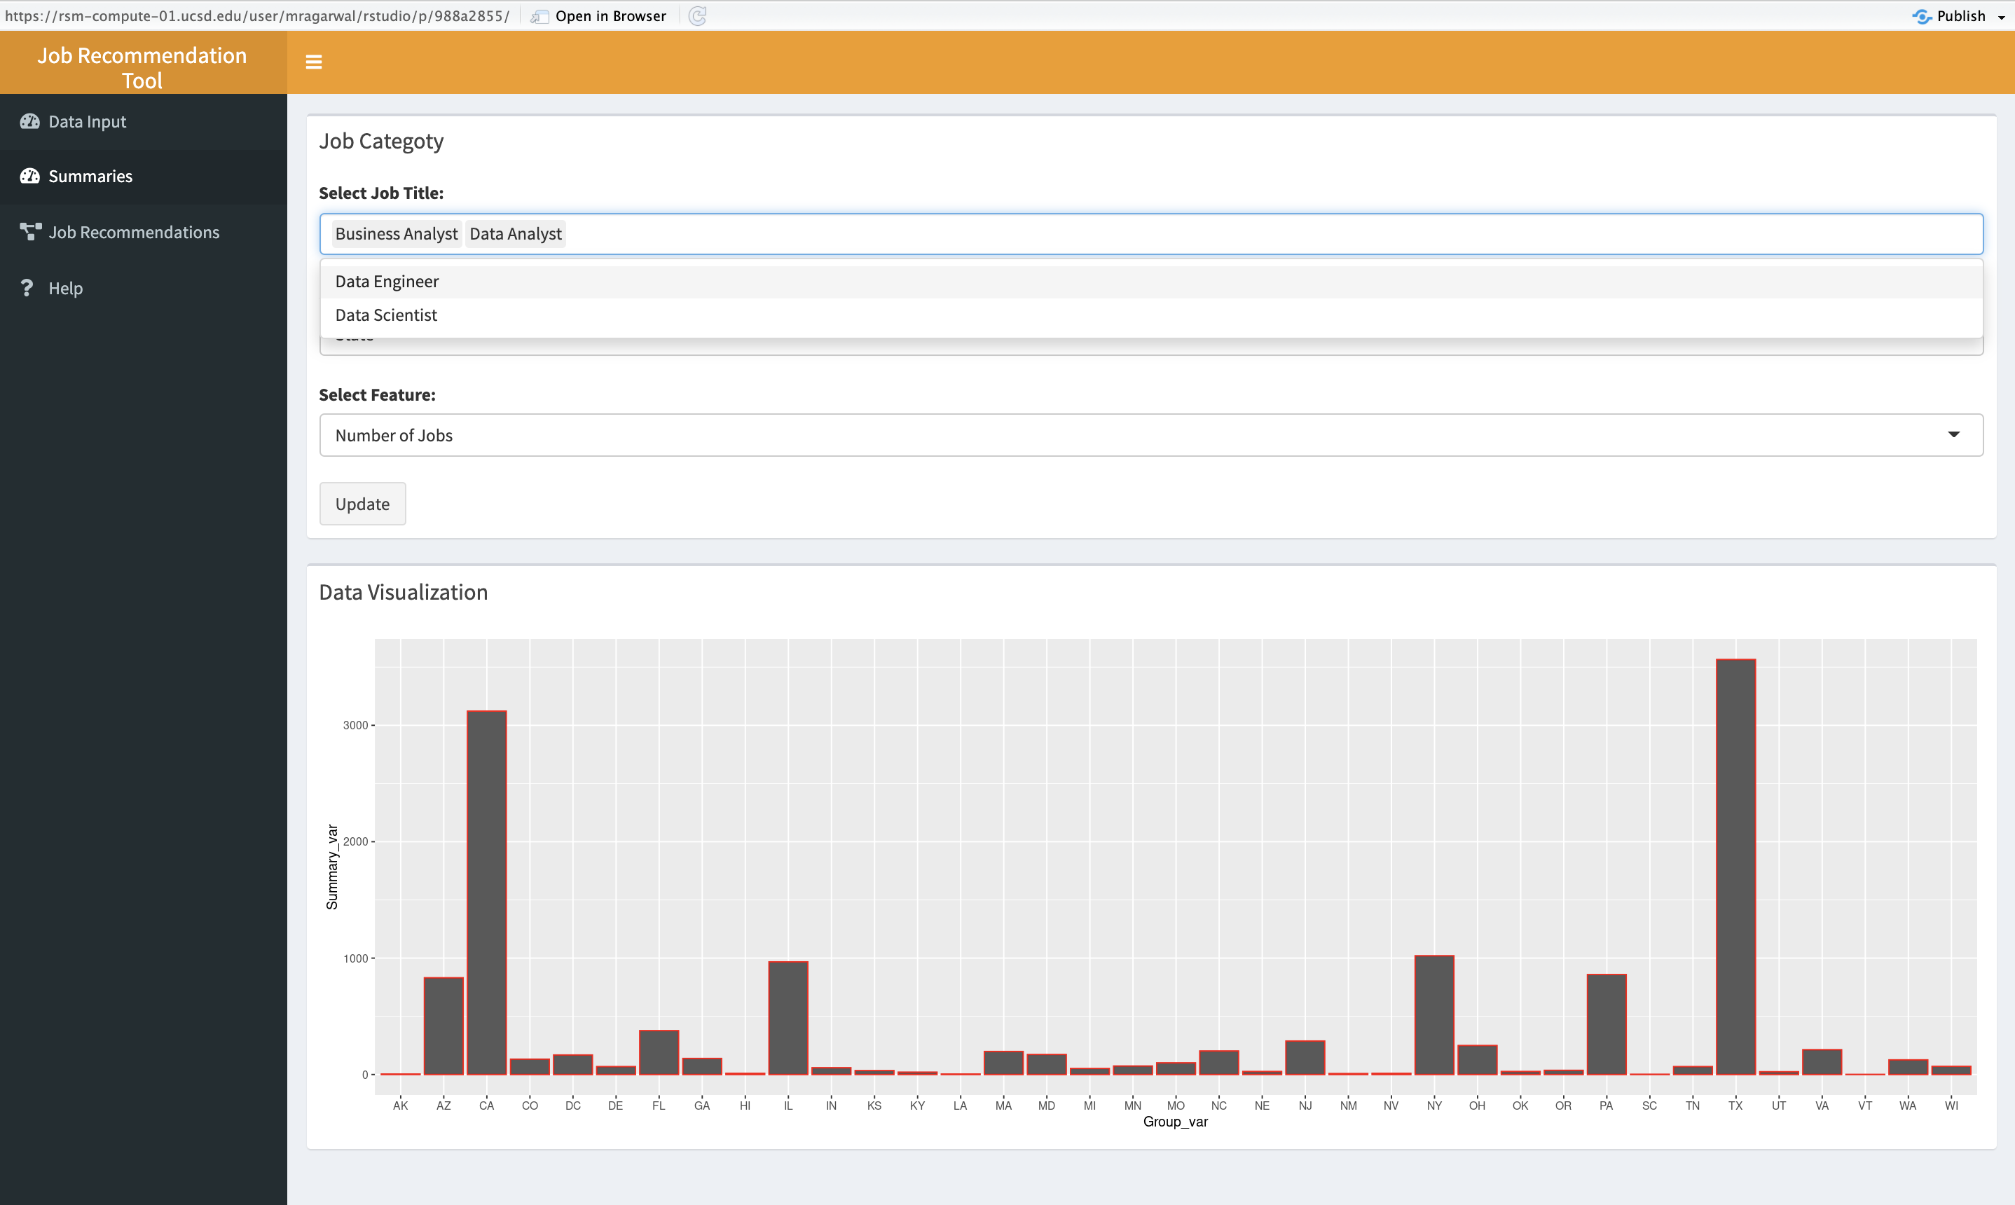
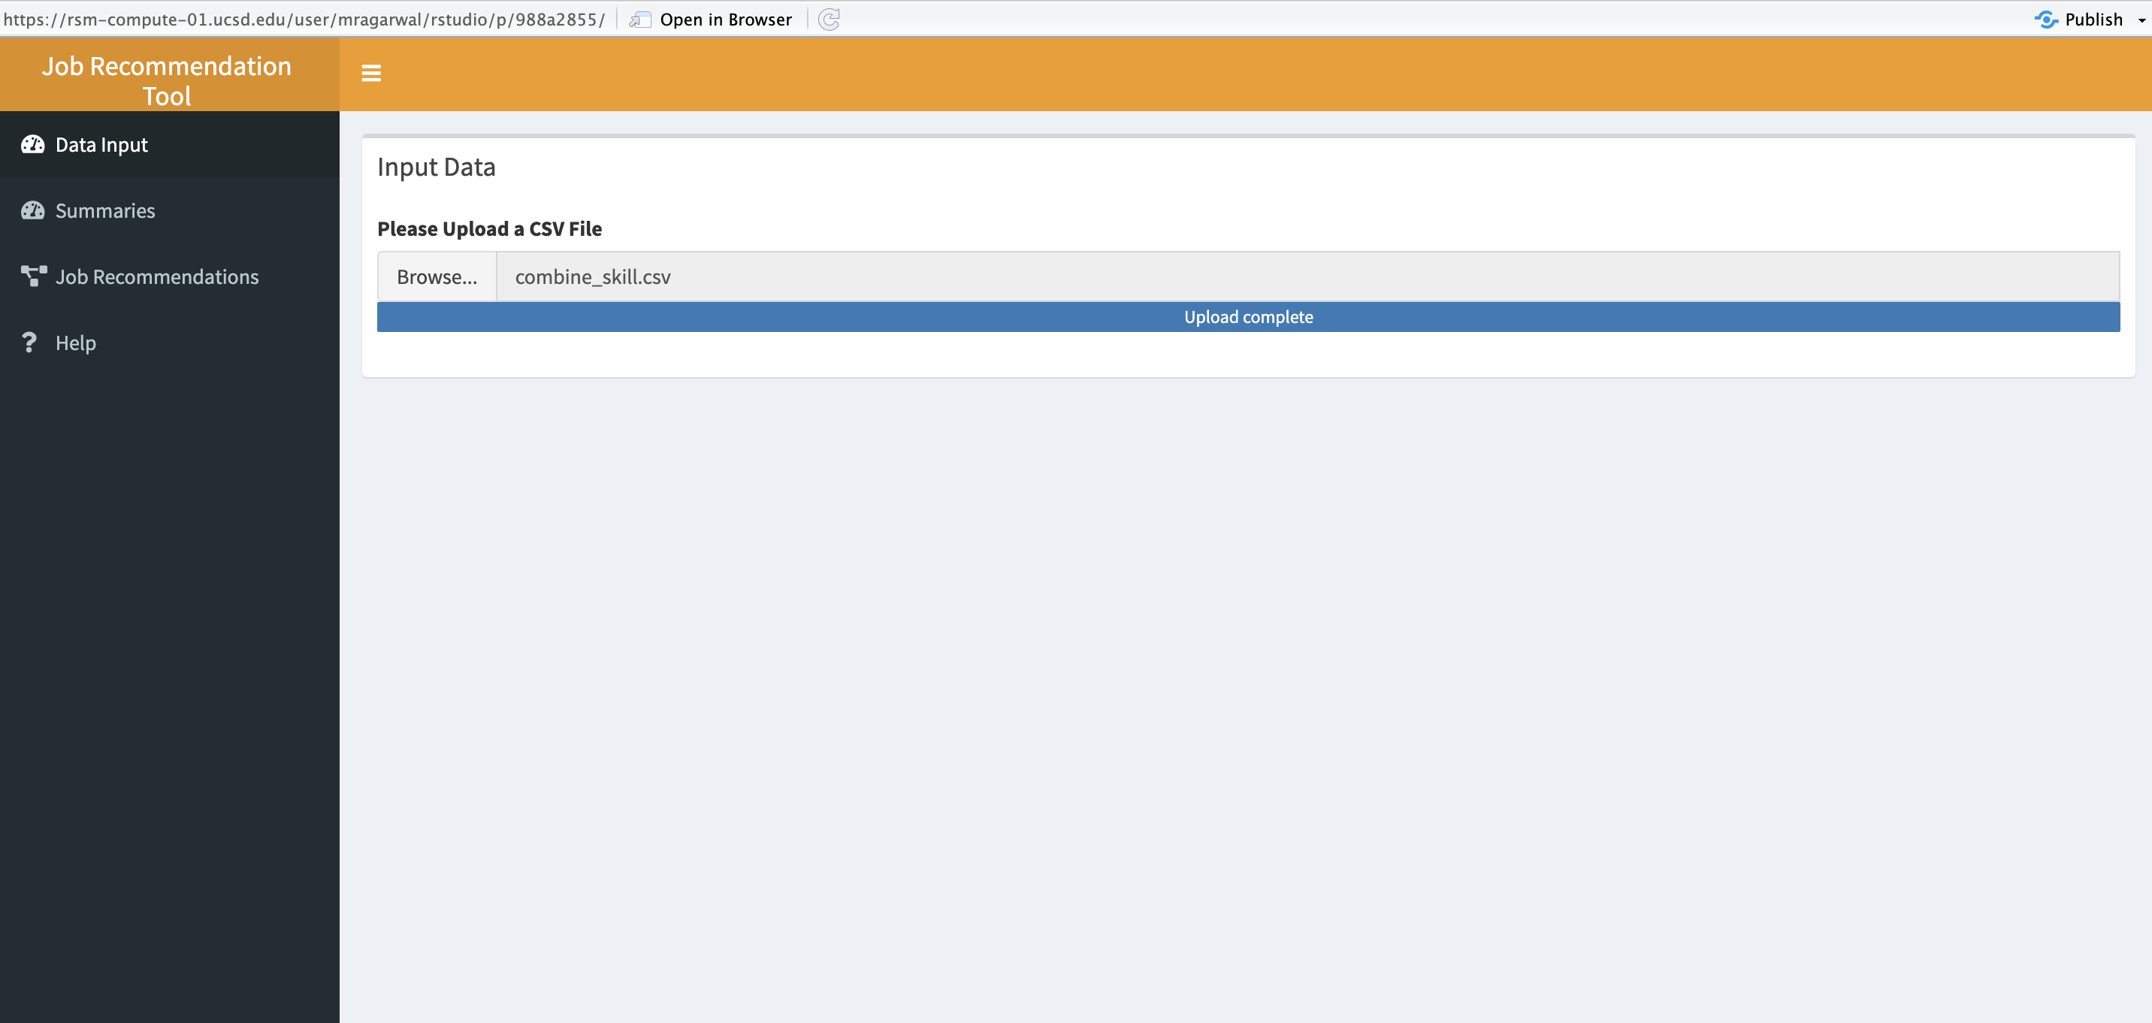
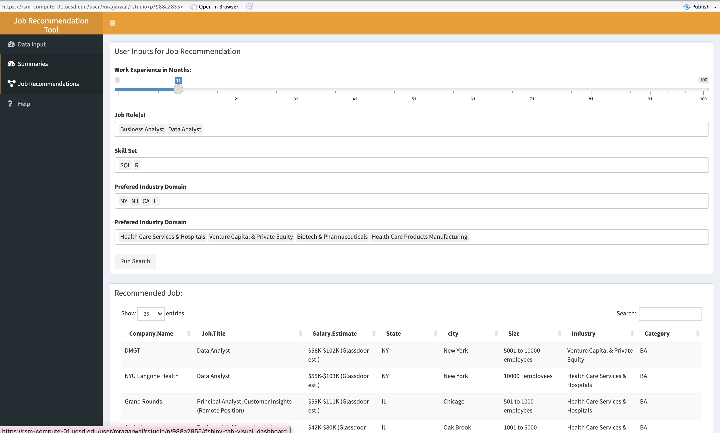
R Shiny TOOL
Dynamic Summaries
Analytics Job Recommendation
Load the Cleaned Scrapped Data

Slide 17
R Shiny TOOL
Tool Demonstration

Slide 18
Future Scope
Improvement and upgradation to the tool-
Automated Scrapping integrated in the tool
Try other recommender algorithms for job recommendation
Add more matrix and summaries based on the scrapped data

Slide 19
Thank You

